Slide 1
METANOIA-History-NDE-Science
Metanoia is like a total life epiphany. It is happening when someone has a profound realization that changes person perspective or outlook on life. A profound transformative change of heart, mind or lifestyle. Often described as a spiritual conversion or “turning point around”. It represents a deep reorientation of one’s worldview moving from old habits to a new, higher perspective. It is a turning away from sin and fully new oriented towards God. A complete change in character of the person. Radical and complete change of thoughts. According to the saints it’s grasping a new view of God there.
Thinking of a major moment that shifts everything. Metanoia is a Greek word that means “change of mind” or repentance”. In psychology and philosophy, it’s like a transformative experience that alters your perception, values, or beliefs. It is also healing process of personal growth. Sometimes is a restructuring of consciousness following a mental “breakdown.” It is a deciding moment of radical shift. It is not just a lightbulb moment; it is more like a seismic shift. Ever had something like that happen to you? Times flies, but eternity waits.
METANOIA-History-NDE-Science
We say each Sunday, “I look forward to the resurrection of the dead and the life of the word to come.”???????? Really? Is it just cliché? What is the biggest motivation for metanoia?
Metanoia is like a total epiphany of a new vison of life. It is happening when someone has a profound realization that changes person perspective or outlook on life. A profound transformative change of heart, mind or lifestyle. Often described as a spiritual conversion or “turning point around”. It represents a deep reorientation of one’s worldview moving from old habits to a new, higher perspective. It is a turning away from sin and fully new oriented towards God. A complete change in character of the person. Radical and complete change of thoughts. According to the saints it’s grasping a new view of God here and there.
Thinking of a major moment that shifts everything. Metanoia is a Greek word that means “change of mind” or repentance”. In psychology and philosophy, it’s like a transformative experience that alters your perception, values, or beliefs. It is also healing process of personal growth. Sometimes is a restructuring of consciousness following a mental “breakdown.” It is a deciding moment of radical shift. It is not just a lightbulb moment; it is more like a seismic shift. Ever had something like that happen to you? Times flies, but eternity waits!!!

Slide 2
Why so easily few atheists and unbelievers had terrorized the entire planet in 2020. What happened with Covid 19. Bill Gates 15 years ago said,” we need to depopulate the number of people in the planet. They said if you don’t accept the vaccine 65 million Americans will die. They scared people because everyone is afraid of death. They attacked with propaganda the instinct of self-preservation. Case of Vladimir Putin, people like to give him the NOBEL price of medicine. ? Why, He stopped the COVID 19? . Case of War Feb 24,2020 - Russia invaded Ukraine. 2 millions Ukrainians came to Poland and nobody died from Covid. The major reason for COVID 19 vaccine refusal was concerns about safety, side effects, efficacy, misinformation, and lack of knowledge.
What Happens When We Die? The title "Dr. Moody" most commonly refers to Dr. Raymond Moody, (06/30/1944) an American psychiatrist and philosopher widely recognized as the "father of the near-death experience" (NDE). He is best known for coining the term "near-death experience" in his 1975 bestseller, Life After Life. First published in 1975, the book Life After Life by Dr. Raymond A. Moody has sold over thirteen million copies worldwide.
His research explores personal accounts of subjective phenomena encountered in near-death experiences, particularly those of people who have apparently died but been resuscitated. Revive from unconsciousness or apparent death. He has widely published his views on what he terms near-death-experience psychology. In his book, Return From Tomorrow, published in 1978).

Slide 3
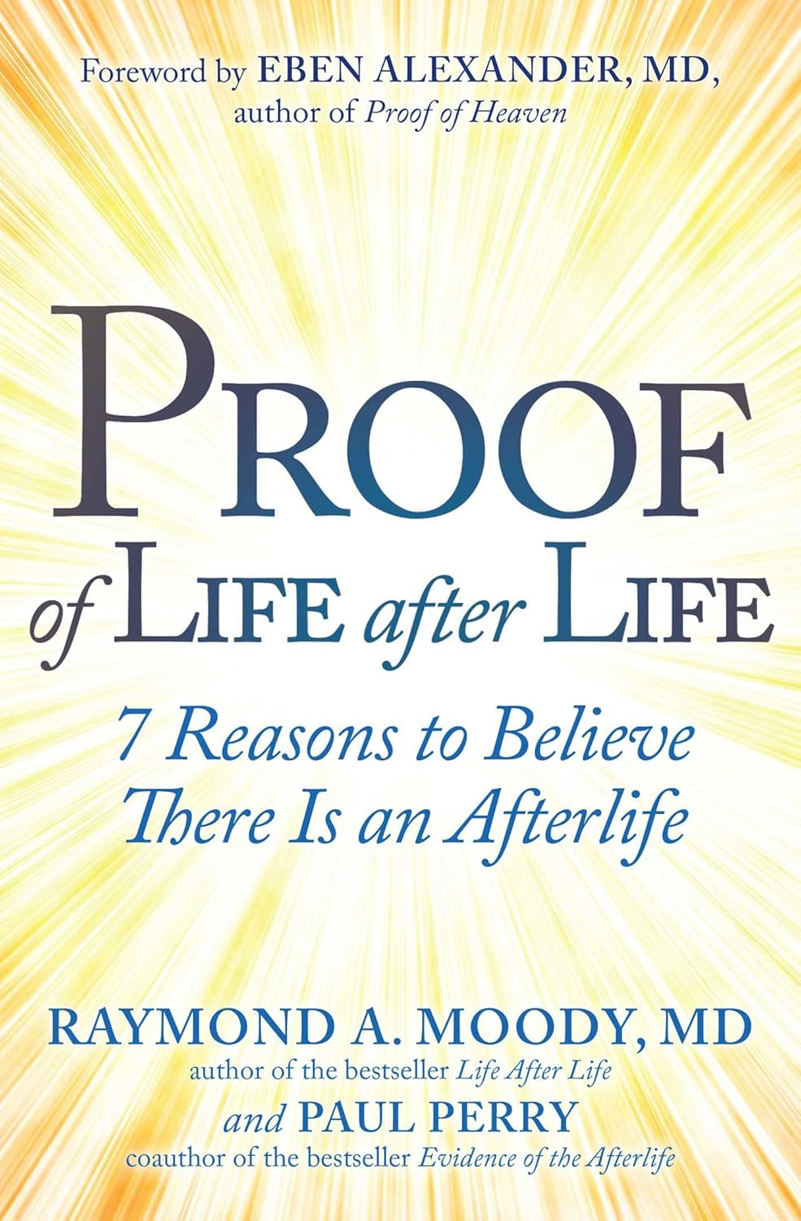
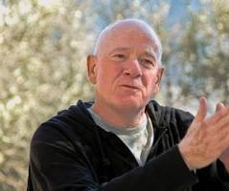
Raymond Moody began documenting similar accounts by other people who had experienced clinical death and discovered that many of these experiences shared common features, such as the feeling of being out of one's body, the sensation of traveling through a tunnel, encountering dead relatives, and encountering a bright light. I don't mind saying that after talking with over a thousand people who have had these experiences, and having experienced many times some of the really baffling, astonishing and unusual features of these experiences, it has given me great confidence that there is a life after death.
As a matter of fact, I must confess to you in all honesty, I have absolutely no doubt, on the basis of what my patients have told me, that they did get a glimpse of the beyond. In 2023, Moody coauthored Proof of Life After Life: 7 Reasons to Believe There Is an Afterlife with Paul Perry with whom he has coauthored seven books. Drawing on nearly fifty years of research, the book presents case studies, expert interviews, and theoretical insights to argue that consciousness survives bodily death.

Slide 4
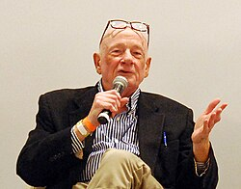
LIFE after LIFE
Science Meets Spirit In Our Exploration Of The Afterlife
It expands beyond near-death experiences (NDE) to explore shared-death experiences, paranormal signs, and broader questions about the soul and afterlife. In 2025, the International Association for Near-Death Studies (IANDS) announced its annual conference will be titled Life After Life: Celebrating the Golden Anniversary of Near-Death Studies, in honor of the 50th anniversary of Moody's groundbreaking 1975 book Life After Life. Raymond received the World Humanitarian Award in Denmark and was honored with a bronze medal in the Human Relations category at the New York Film Festival for the movie version of Life After Life.

Slide 5
Criticism of Moody's near-death research 1. It appears to ignore a great deal of the scientific literature dealing with hallucinatory experiences in general. 2. His methods have drawn criticism from the scientific community, to argue for the reality of an afterlife. 3.The NDE is based on personal interviews and anecdotal accounts. Philosopher Paul Kurtz was largely responsible for the secularization of humanism. Before Kurtz embraced the term "secular humanism," which had received wide publicity through fundamentalist Christians in the 1980s, humanism was more widely perceived as a religion (or a pseudo religion) that did not include the supernatural. In Defense of Reason and Science by Paul Kurtz, et., 1994 Is our faith pseudo-religion?
There will be members of the pastors who will be upset by anyone who dares to do research in an area which is supposed to be taboo. Some religious representatives of a denominational church have already expressed their criticism of studies like this. One priest referred to it as “selling cheap grace.” Others simply [feel] that the question of life after death should remain an issue of blind faith and should not be questioned by anyone. Why not? We have the best advocate in the planet –the Holy Spirit.

Slide 6
The canonical work known as the Doctrine and Covenants contains doctrine that Latter-day Saints believe came to Joseph Smith through revelation from God. In one section, we read that “man was also in the beginning with God [meaning before the world was created]. Intelligence, or the light of truth, was not created or made, neither indeed can be… For man is spirit. The elements are eternal” (Doctrine and Covenants 93:29, 33). Elaborating upon this doctrinal foundation, Joseph Smith taught in 1844 that “the Spirit of Man . . . existed from Eternity and will exist to eternity. A generation later in 1909, the First Presidency of the Church authoritatively redeclared the doctrine of the Church that “all men existed in spirit before any man existed in the flesh.” Wrong teaching according to CCC.
Thus, Latter-day Saints believe that each of us lived as spirit beings before we were ever born into this world. Without an understanding of the doctrine of man’s premortal existence as spirits, it is virtually impossible to understand beliefs concerning the afterlife and the nature of spirits and the spirit world.
Dr. George Ritchie in his classic near-death experience account recorded in Return from Tomorrow, expressed shock that he could actually see his dead body lying on the bed he had just left. “I was me, wide awake, only without a physical body to function in,” Ritchie reported.

Slide 7
Latter-day Saint theological minds—repeatedly taught of the remarkable powers possessed by the departed righteous while in the spirit world. Joseph Smith taught that the spirits of the faithful possessing a portion of God’s infinite power are “enveloped in flaming fire”—fire representing God’s glory and power.
The Book of Mormon provides Latter-day Saints with direct teaching regarding life after death. The ancient prophet Alma recorded that “there is a space between the time of death and the resurrection” (Alma 40:9). Expounding upon that doctrine, Alma explained that he learned from an angel concerning the “state of the soul between death and the resurrection.” He recorded:
Behold, it has been made known unto me . . . that the spirits of all men, as soon as they are departed from this mortal body, yea, the spirits of all men, whether they be good or evil, are taken home to that God who gave them life. They don’t believe in the resurrection of the body!?
And then shall it come to pass, that the spirits of those who are righteous are received into a state of happiness, which is called paradise, a state of rest, a state of peace, where they shall rest from all their troubles and from all care, and sorrow. (Alma 40:11–12)
In stark contrast to the blessed state of the faithful who enter into a paradise at death, Alma explained that the wicked—those who in life “chose evil works rather than good”—are in “darkness, and a state of awful, fearful looking” forward to the “wrath of God” that will ultimately befall them. “Thus, they remain in this state,” Alma declared, “as well as the righteous in paradise until the time of their resurrection” (Alma 40:13–14). Jesus for them was not incarnated God.

Slide 8
Accounts of spiritual encounters with the afterlife cannot change lives and build strength to serve God and resist temptation with the same power and certainty as the word of God. Furthermore, some of these NDE stories and accounts may set forth mistaken or false doctrines that can lead one astray or mislead others about truth. That is why faithful Latter-day Saints view NDEs only as a side dish, never the main course. They are never an adequate source of doctrine or replacement for faith. Relying only on such fare for one’s spiritual nourishment will inevitably cause spiritual starvation. Some things are interesting. Others are imperative.
My conviction of life after death comes to me from God. Death still hurts. Separation from loved ones is still painful. But I am comforted by my hope for a joyful reunion someday and a glorious resurrection. I add my conviction to these poetic words penned by the late Church President Gordon B. Hinckley:
What is this thing that men call death, This quiet passing in the night? Tis not the end, but genesis. Of better worlds and greater light. O God, touch Thou my aching heart, and calm my troubled, haunting fears.
Let hope and faith, transcendent, pure, Give strength and peace beyond my tears.
There is no death, but only change. With recompense for victory won; The gift of Him who loved all men, The Son of God, the Holy One. For them Jesus was only a human being like each of us.

Slide 9
Father Manuel Carreira (1931–2020) was a distinguished Spanish Jesuit priest, physicist, and theologian known for bridging the gap between faith and modern science. A member of the Vatican Observatory, he held a doctorate in physics from The Catholic University of America and spent decades teaching and researching cosmology, quantum mechanics, and the philosophy of science, consistently arguing that scientific discovery and Christian belief are complementary, rather than contradictory, pursuits. He has lectured, with the sponsorship of the Vatican, in many universities of Mexico, Colombia, Peru, Argentina, Uruguay and Chile. Other invitations have led to talks in Germany and Ireland, and in practically every important university in Spain.
He was able to clearly explain the connection between God and Faith and Science. Some suggest that advanced science precludes religion. Father Carreira was able to show that science proves the existence of God and that the two are complimentary, not at odds. "Every human being is naturally a philosopher. We are not satisfied with knowing the chemical makeup of a human being, we want to know the person," says Father Emmanuel Carreira, Jesuit Priest and scientist.

Slide 10
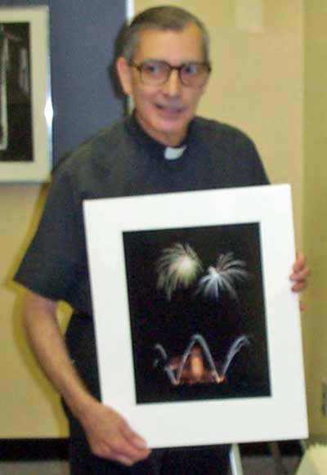
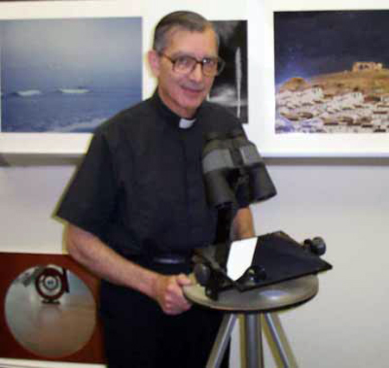
Essays from scientist and Jesuit priest Emmanuel M. Carreira, S.J Emmanuel Carreira SJ, PhD Renaissance Man of Philosophy and Light
Fr. Carreira is a true Renaissance man. He is an astronomer, physicist, photographer, patented inventor, author, painter, poet and Jesuit Priest. "If you give a Chemist the Mona Lisa," he argues, "the scientific method will just tell the chemicals of the pigments - not the artistic worth or value." He goes on to explain that science deals exclusively with the activity of matter that can be proven experimentally and measured. So, Science cannot explain the purpose of life, the meaning of existence or why matter exists. Democracy does not determine truth. If the majority of the people decide that the earth is flat, it is none-the-less round." People do not posses the truth of life, they can only discover the Truth from Man-Christ who said I am the truth.

Slide 11

According to the Apparitions of St. Anne Catherine Emmerich Jesus went to Sheol in the land of the dead. They were waiting for the Messiah there. His presence was the fulfillment of hope. There in Sheol ( Hades) in the land of the dead was the exodus of the righteous. The Messiah delivered those who died from Adam and Eve. All creation recognized its Creator from the beginning. When Mary His mother was praying at home after the crucifixion, Jesus came to her and said to her, "Mother, this has already happened." I have already redeemed the world." Mel Gibson, who read a book about St. Catherine Emmerich, said that the Resurrection is a turning point for the entire cosmos. It was like a cosmic earthquake. Jesus made a new heaven for these resurrected people. Now Mell Gibson is making the movie “The resurrection.”
Blessed Anne Catherine Emmerich 1774-1824 50 years Feast Day: February 9 Beatified 2004 by St. John Paul II Anne Catherine Emmerich was a simple Augustinian nun, visionary, mystic and stigmatist.
She lived only on the Holy Eucharist for the last 11 years of her life.

Slide 12
Christian Faith, Science and Miracles
A most important part of the historical testimony about Christ is the insistence of the witnesses upon facts that proved God's sanctioning of the activities, teaching and personality of Christ. Those facts -miracles- were required in order that accepting his claims would not be considered irrational. Whoever says that he is the Son of God, equal to God, existing before Abraham, of higher dignity than the prophets, entitled to forgive sins, must provide undeniable proofs of those claims. Otherwise, it would be madness to just take him at his word. Faith, in Catholic Theology, is called "rationale obsequious", a rational response to truth.
The Human Body in Eternity: Matter and the Resurrection
Christ's Resurrection is not some kind of pious symbol, nor a mythical expression of some kind of psychological "experience" of the primitive Christian community. It is a historical event, verified by witnesses who saw, heard and touched a living Person they had seen and touched as a dead corpse three days earlier. They proved their certainty and sincerity with their martyrdom. And if seeing a corpse is sufficient proof that the person died, seeing somebody alive after leaving the dead body in a tomb is equally a proof of resurrection, even if there are no witnesses of the moment of death or of returning to life. To deny this obvious logic with word plays about a "meta-historical" event is to leave behind the most basic rationality.

Slide 13
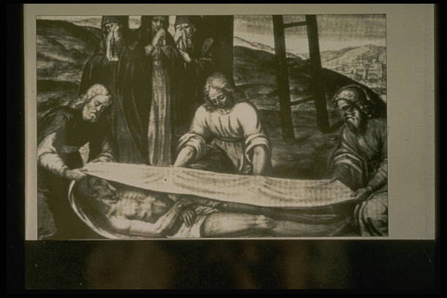
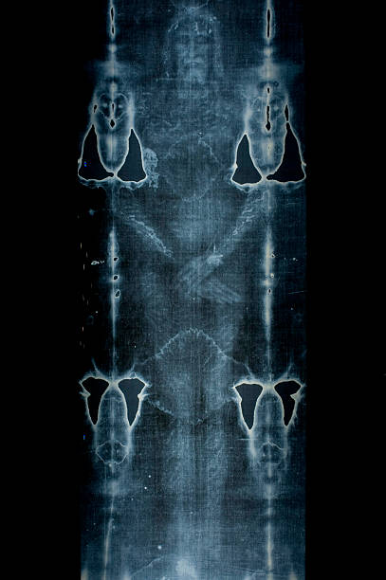
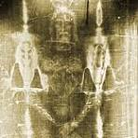
The Shroud of Turin
Aside from the Gospel narratives, there are several relics traditionally related to Christ's Passion, and one -especially mysterious- that is most probably the sheet that wrapped Christ's body in the tomb until the moment of the resurrection. This is the Turin Shroud, the most extensively studied archaeological object in all antiquity.

Slide 14
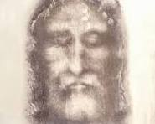
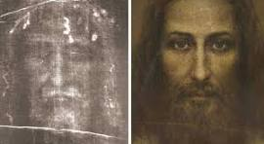
The Meaning of Human Existence: Why, What For, How
No sane person questions the fact of death as the necessary outcome of life in this world. With that perspective, nothing we have acquired has lasting value, not even the possibility of being remembered for a limited time and in a very restricted environment. When I stand before my Creator, the only possible source of eternal happiness, will I consider that I am before a stranger? Will I dare to ask to be accepted to share in the divine life at the most intimate level? If in God's infinite mercy I am granted the grace to see my blindness and repent from it, what a painful shame to realize I have wasted a life that should have prepared me for the Father's embrace!

Slide 15
Because God is Love
God's creating activity cannot benefit Him in any way: a creature, who’s entire being is received from the Creator, cannot add anything to the infinite source of perfection and happiness. The only reason to create must be found in the generous abundance of the essential Good that overflows to share with creatures the radical benefit of existence and, finally, the inexpressible joy of partaking of the intimate life of the Trinity. God creates because He loves, because God is Love.
The First Commandment
Jesus answers with the First Commandment's quote the question of the Doctor of the Law who asks about the most basic and important commandment. He then adds the second one -love of the neighbor- but even if I were the only inhabitant of the Universe, without neighbors, the first precept would still be present with its full impact. It is the response due to the infinite Love of a Creator who gives me existence by pure selfless generosity, because He wants me to partake of his own life and limitless happiness.

Slide 16
Jesus Christ - Head of the Church
The Church is not an administrative structure -a bureaucracy, even without the unpleasant connotation of the term- but a living organism where the vital force is the Spirit of Christ and the Blood that flows from the Head to each cell in the Body. We could say that it implies something analogous to the Incarnation, thus constituting a single Agent of divine and human activities: the actions of human members attain divine value by their union with the only source of supernatural energy, Christ, Head of the Church. Matthew 16:18 “I tell you that you are Peter, and it is on this rock (kefa) I will build MY church.” Not many churches???
Jesus Christ - Joy Eternal
Heaven is not "a place" set in any kind of space, just like eternity is not an interval of time. In his Resurrection Christ begins to exist free from the space-time framework that limits matter and its activities, and "heaven" is the name for a new kind of life for which all our images -born from sense impressions- are inapplicable. "Eye has not seen, nor ear heard, what God has prepared for those who love Him", ( 1 Corinthians 2:9) and any effort to imagine this new kind of life will always be inadequate.

Slide 17
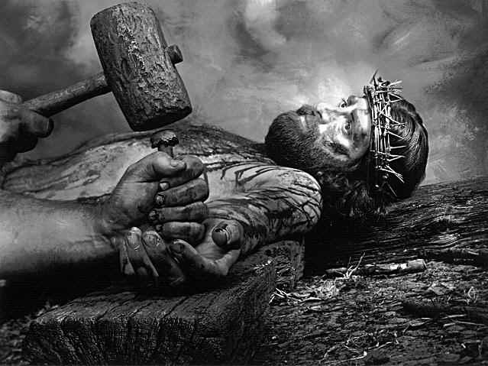
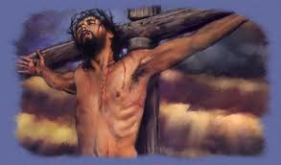
Suffering, in a World Created by a God Who is Love
What can the answer be, logically and theologically, to the obvious query: How can God have made a world where there is so much pain, so much EVIL? The station of the cross Nr; XII. Life eternal, death defiant, Bowed his head-the world was silent, Through his death came new. life anew.

Slide 18
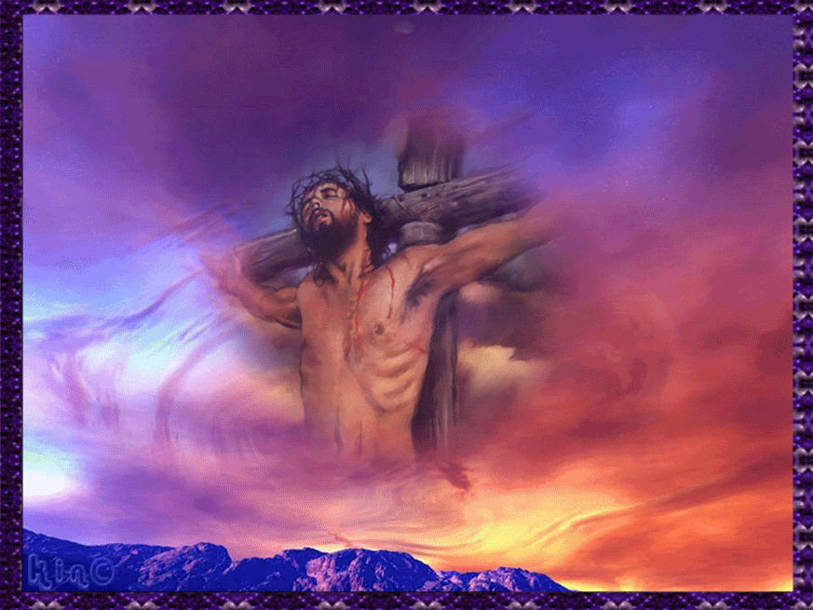

Slide 19
Christ, Truth Incarnated
Due to this unique relationship, the Son is essential Truth: when Christ said "I am the Truth" -a statement that might sound incomprehensible to us- he is not simply referring to himself as a Master of true knowledge, but to his intimate nature as a divine Person. His coming into the world is the mission of communicate and clarify the eternal Truth: "I came for that purpose, to testify to the Truth". Because "nobody knows the Father except the Son, and those to whom He gives that knowledge" "Nobody has ever seen God: the only begotten Son, always in the Father's bosom, has manifested Him".
Christ, the Key to History
To state that Christ is the key to History may be just a symbolic phrase, poetic and perhaps lacking in rigorous meaning. To avoid ambiguities, we must define concepts: What do we mean by "history"? By "key"? Only thus can we establish a logical connection between both words and see in what sense their meaning can be applied to the Person of the God-Man. John Paul II, said, “ We cannot understand fully who we are without Christ.”
.

Slide 20
Christ, the Son of God
Because the divinity of Christ is a necessary consequence of his sonship, since every living being communicates its nature and the Father can only give to the Son the divine nature that is his very essence. The concept of a true generation, when we speak of a spiritual and unchangeable Being, has to be applied in an analogous way with respect to the biological level where life is shared as something clearly distinct and independent of the generating organism, in a process that includes a material division of parts.
Logos - The Prologue of the Gospel of St. John
"In the beginning was the Word..."If a literary analysis were sufficient to show that a written text is due to a supernatural influence and not to human wisdom and reasoning, the opening page of St. John's Gospel would be the most likely example of divine inspiration. Nothing similar was ever part of any philosophy or mythology. It is just unthinkable that a fisherman from Galilee, 2000 years ago, might have produced it by his reasoning power.

Slide 21
Bethlehem, the Eucharist, the Church and Mary
It might seem rather daring to add to this beautiful Prologue (St John's Gospel) any other comment, no matter how well founded it might be. But the reality of the Incarnation leads us to insist on the fact that the Son-made-Man always appears and acts clearly expressing the double message of his Sonship and his role as manifestation of the Father, as the Word of Truth.
Jesus Christ, the Reason for Creation
Can something be created from NOTHINGNESS? Ask Albert Einstein? The very existence of the Universe at all levels, from the most perfect angels to the most humble matter can only be understood in terms of its relationship to Christ. Only with an absurd lack of reverence can another historical figure be compared to Him. And it is impossible to understand anything about Christianity if we do not establish, from the start, this primacy of nature, activity and honor that belongs only to the Son of God who became the Son of Man.

Slide 22
God, Creator and Father
Why did God create persons, intelligent and free? Why did God create matter, after creating the angels? Why did God create human beings?
Why was there no repentance or redemption for the fallen angels? Could the Son of God have become an angel? Why was Christ born of a virgin?
Why is there no repentance after death? When is the resurrection taking place? Why is God addressed as "Father"?
An effort, based on scientific and philosophical considerations, meant to deepen our understanding of the basic tenets (dogma) of Theology, and to give a clearer picture of our dignity and our destiny.
The answers for these questions gave us St. Paul in his letter to 1 Corinthians 13,12,” For now we see through a glass, darkly; but then face to face. At present I know partially’ then I shall know fully, as I am fully known. So, faith, hope love remain, these three’ but the greatest of these is love.” The current human understanding is limited and partial compared to a future, perfect, and comprehensive knowledge. The “day” refers to the perfection of Heaven and the return of Christ. In heaven those who will be saved will be known by God as they are, and they will know Him with the same level of complete intimacy.

Slide 23
Evolution in Living Forms: Determinism, Chance, Purposeful Design
The fact of evolutionary change taking place across the full range of plant and animal life is imposed on us by the fossil record from the most primitive single-cell organisms of 3.5 eons ago to the amazing variety of present-day life on Earth. There is no evidence either in science or in Theology to lead us to think otherwise. We could even argue that a direct creation of each species with the subsequent elimination of ancient forms, to be replaced in toto by new unrelated ones, would be almost tantamount to a deceptive stratagem on the part of an intelligent and truthful Creator. Once evolution is admitted, it becomes necessary to give a sufficient reason and a believable mechanism to explain how it actually took place. While the way life evolves is mostly a problem for Biology to solve, with basic knowledge of genetic variability and transmission providing the general framework, the detailed process for change that leads to improved fitness for the environment and survival or extinction is still debatable and far from satisfactory.
The Creation Account of Genesis in the language of Modern Science
Continuation and conclusion of the Astronomy and Creation essay. It would be a mistake to read Genesis as if it were a book of Cosmology or Biology, thus being forced by a blind faith to deny scientific facts regarding cosmic evolution or the evolution of life on Earth. But, in a simple language, very important truths are presented, not to be forced artificially into a scientific straightjacket nor -as an alternative- dismissed by a myopic scientificism.

Slide 24
Immaculate - Full of Grace ( Without Mary’s YES (Fiat) there will be no Christianity.)
The dogma about Original Sin presents Man in a state of denial and isolation. It is not the same as a personal sin, the result of a conscious act of a rebel free will, that seeks the proud independence of denying the essence of a created being to become an absolute arbiter of good and evil. Personal sin has its own negative reality and it isn't simply an absence of some good, even if this is also its inevitable consequence. Jesus Christ, Source of Life
The coming of Christ into the world clarifies the meaning of human life, now understood within the design of the living God who created us as his Image and Likeness. Even if death came into the world through sin and it seems to destroy the divine plan, the theme of life continues to be underlined throughout the Old Testament, reaching the clear statement of destiny to an eternal life (that includes the human body) in the heroic confession of faith of the Maccabee brothers and their mother. God is alive, constantly contrasted with the inert idols; his actions in regard to Israel are life-giving, especially when He forgives and "raises" a people that abandoned the living God to follow dead and fictitious gods.

Slide 25
Agnosticism, Atheism, Theism
Let us begin with the fundamental question: Why is there something instead of nothing? The best scientists have acknowledged that this is the most important query, after studying the data about the structure and evolution of the Universe. Look at the life of Adolf Hitler ( he hated religion) or Joseph Stalin? He killed 15 million his folks even own children. He was 5 years in Orthodox seminary but as he was leaving it, he said,” God does not exist,”
Renowned astrophysicist and long-time collaborator of the Vatican Observatory, Jesuit Father Manuel Carreira, told a group of Peruvian young people that “faith is not a feeling and must be backed up with reasons, for it is a rational act.” Immanuel Kant -Philosopher, said the same, you prove God’s existence only with reason.
Many famous historical and modern scientists have expressed belief in God or a higher power, including Isaac Newton, Galileo Galilei, Michael Faraday, Gregor Mendel, Max Planck, Georges Lemaitre, and even Albert Einstein (though his belief was more pantheistic, aligned with Spinoza's God of nature). Figures like Newton saw God in the universe's intricate design, while Lemaitre, the father of the Big Bang theory, was a Catholic priest, and others like Francis Collins, head of the Human Genome Project, found faith through personal experiences.

Slide 26
God cannot cease to exist. The most interesting truth is that we shape our ultimate future today. What will happen to our bodies after death and what will our resurrected body be like? What is the post-mortem procedure for man. After death, there will be two judgments; the first detailed one right after his death. The second, the final one, with the end of the world, when Christ comes for the second time.
Hebr. 9:27-28 „Just as it is appointed that human beings die once, and after this the judgment, so also Christ, offered once to take away the sins of many, will appear a second time, not to take away sin but to bring salvation to those who eagerly await Him.” Filp.1:21-24,” For to me life is Christ, and death is gain. If I go on living in the flesh, that means fruitful labor for me. And I do not know which I shall choose. I am caught between the two. I long to depart this life and be with Christ for that is far better.” 2 Cor 5:6-8.” So, we are always courageous, although we know that while we are at home in the body we are away from the Lord, for we walk by faith, not by sight. Yet we are courageous, and we would rather leave the body and go home to the Lord.” 2. Last Judgment of the nations in Matt. 25,31-46 “When the Son of Man comes in His glory, and all the angels with Him, He will sit upon His glorious throne, and all the nations will be assembled before Him. And He will separate them one from another, as a shepherd separates the sheep on his right and the goats on the left. Then the King will say to those on his right…Inherit the kingdom prepared for you from the foundation of the world… Then he will say to those on His left. Depart from me you accursed will go to eternal punishment, but the righteous to eternal LIFE.”

Slide 27
Wrong teaching of the liberal people gives a trap saying that “We will all be saved”.?????
About the purgatory we have in the Bible 12 quotations. About Hell we have 14 quotations. Saint Anne Catherine Emmerich said,” I saw the poor souls in purgatory. I saw their desolation, their inability to help themselves, and the little assistance they get from the living. Ah, their misery is inexpressible.”
The purgatory saw also Sister Faustina Kowalska and children from Fatima.
At the end of time, the Son will one day return in glory to judge the world and separate those who have done good from those who have done evil. Those who have done works of charity empowered by grace will merit the resurrection of life. Those who have neglected these good works and committed evil will merit the resurrection of judgment. (John 3:16-17) Gospel from Last Wednesday. The Spirit will “convince the world of sin and of righteousness and of judgment” (John 16:8). THE Spirit will guide Jesus’ disciples into all the truth. (John 16:13)

Slide 28
Heaven- according to many saints they say that the intensity of experiencing happiness will be very various. Souls look at God according to different merits, some of a more perfect vision than those of a less perfect one.
Saint Paul in his letter to Corinthians 15 teaches of the resurrection of the body.1 Cor 15:36 “You fool! What you sow is not brought to life unless it dies, 42: “It is sown corruptible; it is raised incorruptible. It is sown dishonorable; it is raised glorious. It is sown weak; it is raised powerful. It is sown a natural body; it is raised a spiritual body.” 1 Cor 15:55 “death is swallowed up in victory. Where, O death, is your victory? Where, death, is your sting?” The sting of death is sin. Christ defeats sin the cause of death.
John Paul II preached and lived this cry throughout his life: "Do not be afraid", each of us can do it. What does it depend on in order not to be afraid of adversity in life and even death. There is only one answer, it depends on a decisive, clear and mature decision, knowing that at the end of the road of our lives the beloved Heavenly Father awaits us. Socrates and Plato, the fathers of the philosophy of wisdom, said, “A man who does not know the answer to the question of what awaits him at the end of the path of life, what is his personal purpose of life and action, does not know how to live and how to arrange for himself,” the only life here on earth on which your entire eternity depends. The vision of Heaven is something of a model for how to establish your rules of life on earth. One thing is certain, that I can irretrievably waste myself and deserve to be rejected for eternal happiness. Today, the whole culture tells man every day, Poet Horace’s, saying "Carpe diem", means "seize the day, there is no hell and no judgment. Media today tell people „Take action immediately and pursue passion without excessive worry.

Slide 29
God loves us, but precisely because He loves us very much, He takes us seriously and does not underestimate our sins. Sirach in chapter 1 says,” Fulness of wisdom is fear of the Lord. The root of wisdom is fear of the Lord. All wisdom comes from the Lord.”
Recent testimony of the Polish Priest Wictor Szponar doctor of theology currently teaches students in Gdansk, wrote the book “life after the death”. Interviewed about 200 people who were close to the border of death. All saw the light at the end of the tunnel. He described about one exceptional example of the young man MIRION who was a gay and his friends made fun of him. He couldn’t handle it mentally. So, he decided to hang himself and went to the basement and accidently his mother was looking for food and she untied him nearly dead. Miron coming back from the border of death told his mother.” Mom, I saw it up there my brother. “No, no son, you don’t have any brother she said.” Yes, mother I spoke to him, his name is Mattew. In that moment she burst into tears. Then crying she confirmed it telling him, yes, it is true, before being married to your father I was raped and I had an abortion. I was in big depression and silently I gave him the name Mattew I never talked about this. I did not tell anyone about it-not even your father. After such a profound experience MIRON decided to change his life entirely and he did not return to his old way of life and lived in purity. He experiences a full metanoia.

Slide 30
Witnesses of the movie the Passion of Mel Gibson said. “ It is all so true and obvious, and in my heart I feel that I am only a pilgrim for a moment on this earthly field, and if I keep the teaching of Christ, I will enjoy joy in this world, where there is no more lies, hypocrisy and sorrow, only peace and love and the holy figure of Christ, but whether I deserve this reward of seeing the face of the Lord, everything depends on my life here on the earthly life, Has none of my neighbors wept because of my works? So let us live the teaching of Christ, and then there is hope that we will see this true light of God's love!!!!
Jesus, I trust in You, For who but God. I remind the unbelievers that the Lord Jesus Christ is Risen and Alive, and Glory be to God for this AMEN
Lord Jesus, stay with me for all eternity. How beautiful You are, Lord Jesus Christ, no words will speak, no love will be confessed, no love will be uttered, no one will confess Your love, Lord Jesus Christ.
If everyone believed so intensely in Christ, there would be no wars, no falsehood, no hypocrisy and no hatred.
We are blind and we do not want to believe in Him.
Rich people want to be the owners of the world and all of humanity, they make themselves gods, they have rejected truth, all morality, decency and have lost their humanity to satanic mammon, hypocrisy has replaced truth and law. They have turned truth into a lie, and introduced evil, perversion, greed and beasts, calling it modern good. Can hypocrisy and evil triumph over good?
Non-believers say that the Gospel and the Passion Film are one utter lie. Who do you believe?

Slide 31
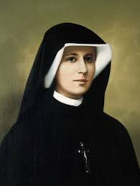
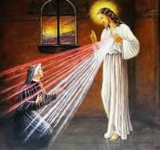
Divine Mercy according to Faustina Kowalska. What did Jesus say to Faustina?
What is the greatness of God's love. By looking at Jesus suffering on the cross, we can understand a little more about how Jesus loves you. Jesus tells us about this great, indescribable love, about this love of God, to Sister Faustina (1059), number in Faustina's diary), there are these incredibly important words for us. These are the refreshments of our hearts. Hearts burdened with the awareness of the guilt and the burden of the sin we have committed.
Jesus says, "I desire trust from my creatures. Sister, encourage souls to great trust in My unfathomable mercy. Let not the weak, sinful soul be afraid to draw near to Me. And even if she has more sins than sand on earth, all this will be drowned in the abyss of My mercy." Jesus does not want you to be perfect. He says, "I want you to be trusting. trust in Me with all your heart. Let not thy soul, thy sinful soul, be afraid to draw near to Me. It was for you that I suffered.”

Slide 32
“Draw close to Me in all your weakness, in all the experience of your own sinfulness. Don't run away, don't hide. Do not run away from my forgiving Love. Don't distance yourself from me. Choose the opposite direction in your thinking, when all the fears in your soul are telling you there is no salvation in you and you think I am not worthy of such love. He did not condemn himself, look at My forgiving Love. All this appears in you as a consequence of sin. Turn to me, because my open hands on the cross want to embrace you. Son, daughter, I am here for you.”
“ I am God and for you I became man, therefore, as a man, I know well the mechanism of your escape from my Love. Draw near to me and fear no more. Approach gradually like a frightened creature and trust in Me. Remember all your sins will be drowned in the abyss of My Infinite Mercy. See: how much sand is there on earth? Can it be counted?” When asked, Artificial Intelligence replied that it is impossible to count how much sand there is on earth. The Sahara Desert has millions of square areas and has about 10 billion cubic meters of sand in the form of various structures. That's more than 15 trillion tons of sand material.

Slide 33
“Now imagine: every grain of sand can be your one sin. Your enormity of sins, however great it may be, may therefore drown in the abyss of My Love, if you only repent and forgive for every sin and My Love does not count it to you. For My Mercy is greater than all the grains of sand on the planet. Your sins will be drowned in My Love.” Don't walk around with grains of sand in your pocket, and don't burden yourself with that land of sin that grieves you. Come to Me, for I am waiting for you in every confessional. It is I who stand behind every priest and I have given everyone the right to absolve you, because it is I who forgive you, not him. He is only My instrument to let you know that it is I who forgive you because of My Love. Forgive yourself too and believe that it is I, the Christ, who purify your soul.”

